Slide 1
Neural Network Chess bot
João Gaspar, Gabriel Santos, Panagiotis Lekos

Slide 2
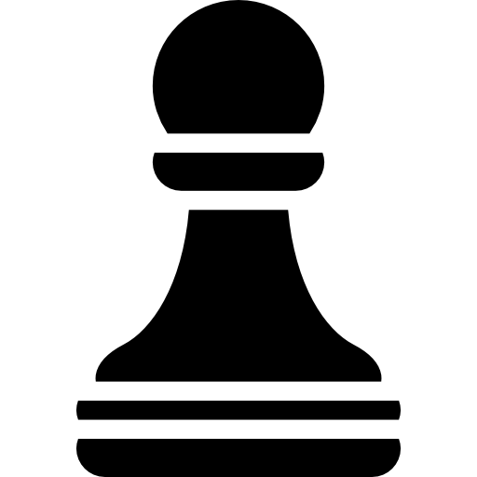
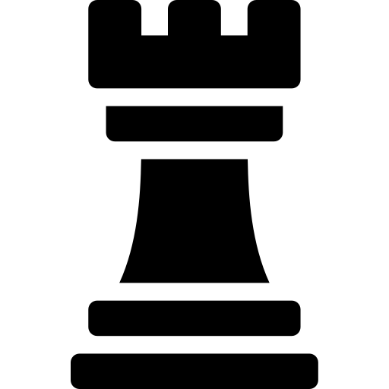

Goals and Vision
Create a Chess bot that is playing both
Mimic decision patterns of human Players
High Quality Moves
Achieve Competitive Performance
Learn openings Achieve opening theory

Slide 3
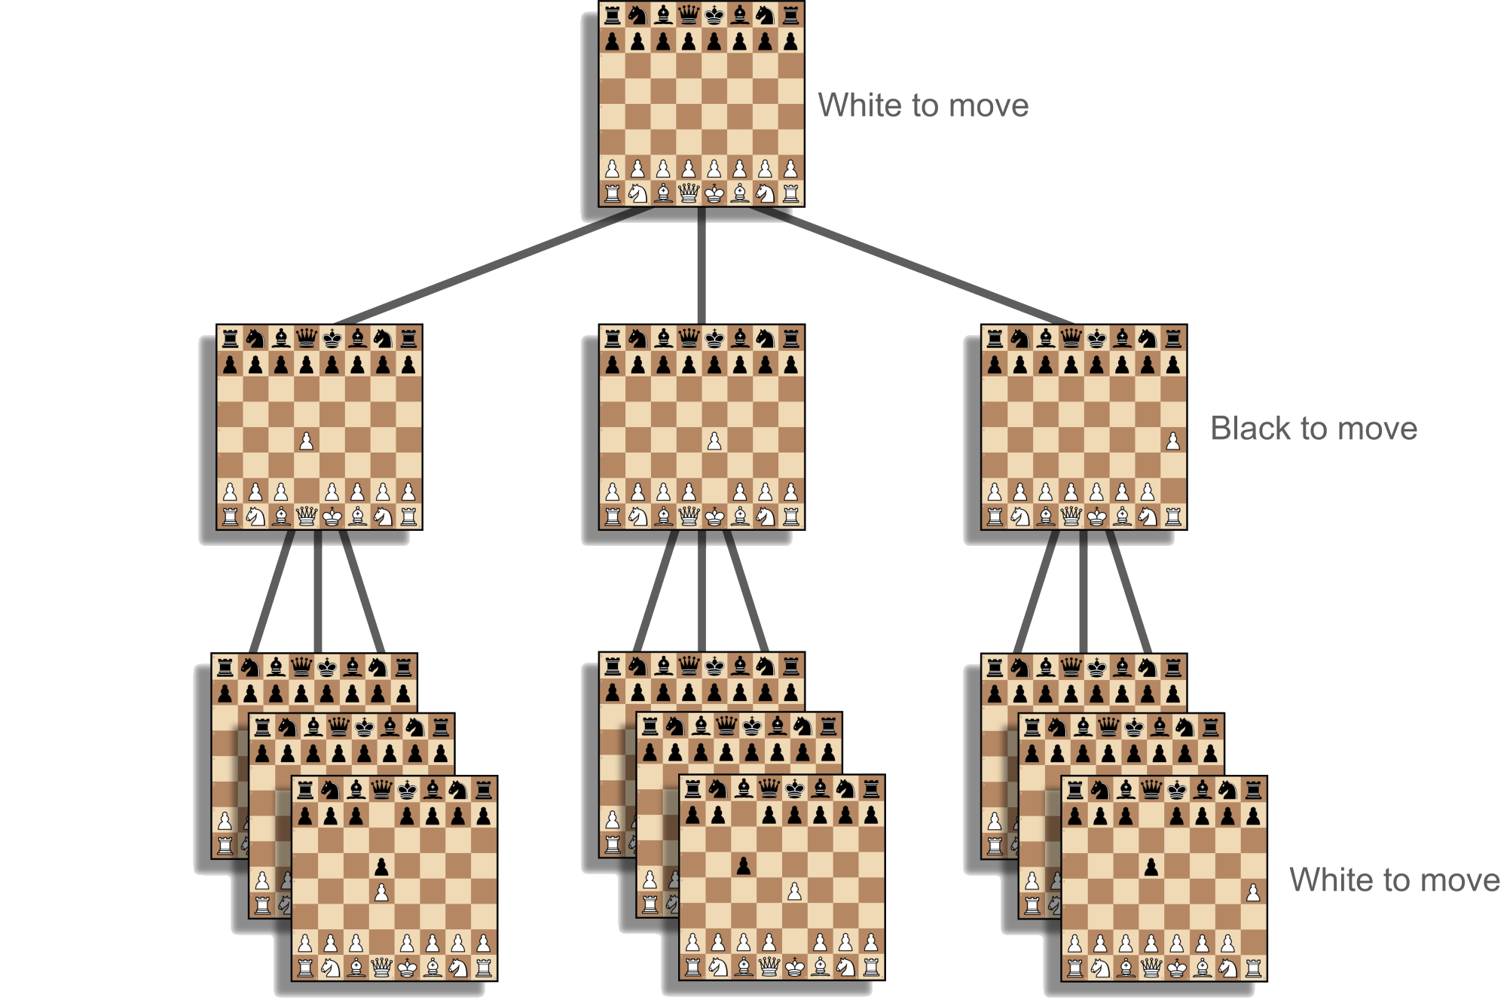
State of the Art
Stockfish
Tree search
Using Efficiently Updatable Neural Network
Evaluating millions of positions per second
Alphazero
Reinforcement Learning
Deep Neural Network
Monte Carlo Tree Search
Superhuman performance
Leela Chess Zero
Follows AlphaZero’s principles
distributed training with community-contributed games
Maia Chess
Focused on human-like move prediction
Convolutional Neural Network
Honorable mention to Nikolai’s bot.

Slide 4
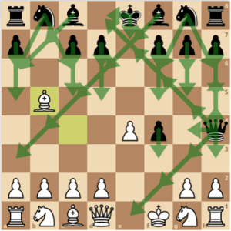




Core Approach
Convolutional Neural Network
Dataset pre processing
Predict human moves from board states
Legal move masking
Dual models (Black/White)
Dataset and training optimization
It was simpler to start as black just to also test a more defensive approach, and a response approach, so we also don’t have to force first moves as white

Slide 5
Dataset
First approach: Kaggle (Lichess games)
Size: 6.5 Million games
Problems
Included bullet/blitz games (low-quality moves)
Required heavy filtering → 2.5M moves extracted in 45 mins
Games from whatever ELO (although they were filtered)
Second approach: (https://database.nikonoel.fr/ - database of elite Lichess games)
Size: 10 Million moves
Problems
There weren’t really any problems associated with this dataset. The games being of 2200 ELO above raised some concern if the bot would be able to interpret them, but since it plays the moves by probability, and these high ELO games are much more stable. (As we can see by the openings)

Slide 6
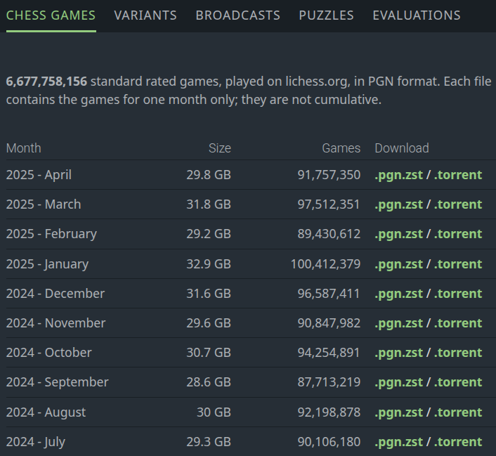
Dataset
Final Dataset: Nikono’s Elite Lichess Database
Pre-filtered for elite players (ELO ≥ 2200)
Excluded bullet/blitz games→ 20M moves (10M White + 10M Black) in 45 mins
No manual cleaning needed
This is the lichess database with all games monthly but in our case we go to a specific website to pick up only elite games.

Slide 7


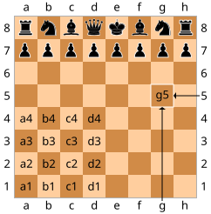
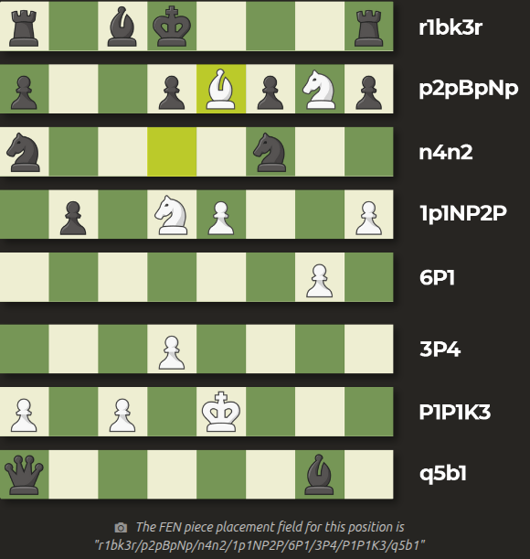
Data pre-processing
First approach:
PGN Cleaning
Removed annotations (move comments, engine evals, symbols like "?!" or "!")
Tokenized moves into Standard Algebraic Notation (SAN)
Opening Moves Skipping
Discarded first 4 moves of every game
Board Encoding
Created 13-channel bitboard tensor 12 binary layers (8x8): One per piece type/color 13th channel: Side to move
Move Representation
Mapped moves to 4,032 possible classes (64 start squares × 63 target squares)
Legal Move Masking
Generated 63 UINT64 arrays per position Marked legal moves
"r1bk3r/p2pBpNp/n4n2/1p1NP2P/6P1/3P4/P1P1K3/q5b1"

Slide 8
Data pre-processing
Final approach:
PGN Cleaning
No manual cleaning. Used python-chess library
Not skipping Opening Moves
Need to learn openings
Skipping is against our neural network chess bot approach
Board Encoding
12 channels only (removed 13th "side to move" channel)
Separate model for White/Black
Reduce complexity
Color specific strategies
Move Space Reduction
Only included moves actually played in the dataset
From 4,032 to ~1,950 classes
Abandoned Legal Move Handling
Model learned legality implicitly from data

Slide 9


Model Architecture
Possible ponderated choices:
Stockfish-style (Tree-search + NNUE)
AlphaZero (Reinforcement Learning + Monte Carlo Tree Search)
Maia-like CNN (Human move prediction)

Slide 10
Model Architecture
Chosen Architecture: CNN
Layers
Input: 12×8×8 bitboards (piece positions)
Conv1: 3x3 kernel → 64 channels BatchNorm + ReLU
Conv2: 3x3 kernel → 128 channels BatchNormalization Process + ReLU
Flatten → 8192 (8×8×128) - dim vector
FC1: 256 nodes (ReLU)
Output: ~1950 nodes (Softmax for move probabilities)
Classification type of problem
Cross Entropy Loss Function
We have 12 channels one for each piece and where the piece is at in the bitmap while Nikolai had an extra channel to where other pieces could move to.

Slide 11
Model Architecture
Hyperparameters:
Batch Size (why we chose it)
Learning Rate
Number of Convolutional Layers
Number of fully connected Layers
Convolutional Layer Kernel Size
Convolutional Layer Kernel padding
Number of Channels in each Convolutional Layer
Not always the results from validation loss (underfit and overfit problems), batch loss, accuracy, etc, are valid/objective metrics for a better playing model (One of our first models had a lower amount of loss and higher accuracy than our current, but objectively was awful)

Slide 12
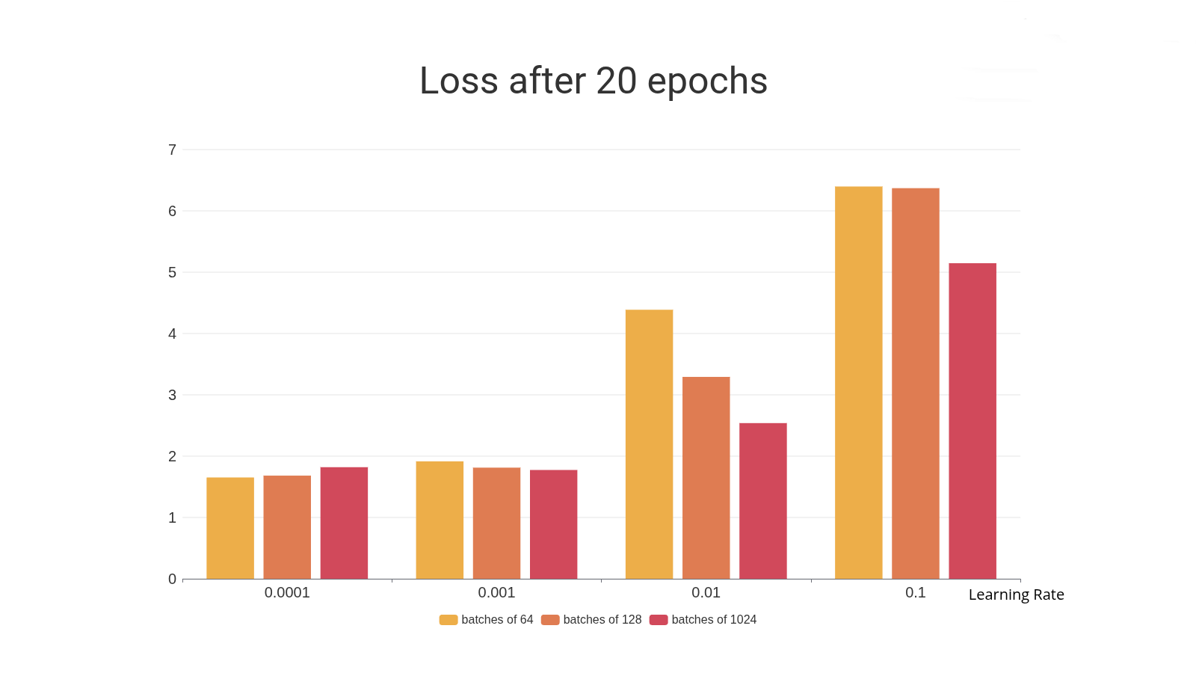
Model Architecture
Hyperparameters:
Tested different values of Batch Size and Learning Rate to optimize the Loss.
Ended up with:
Learning Rate: 0.0001
Batch Size: 64

Slide 13
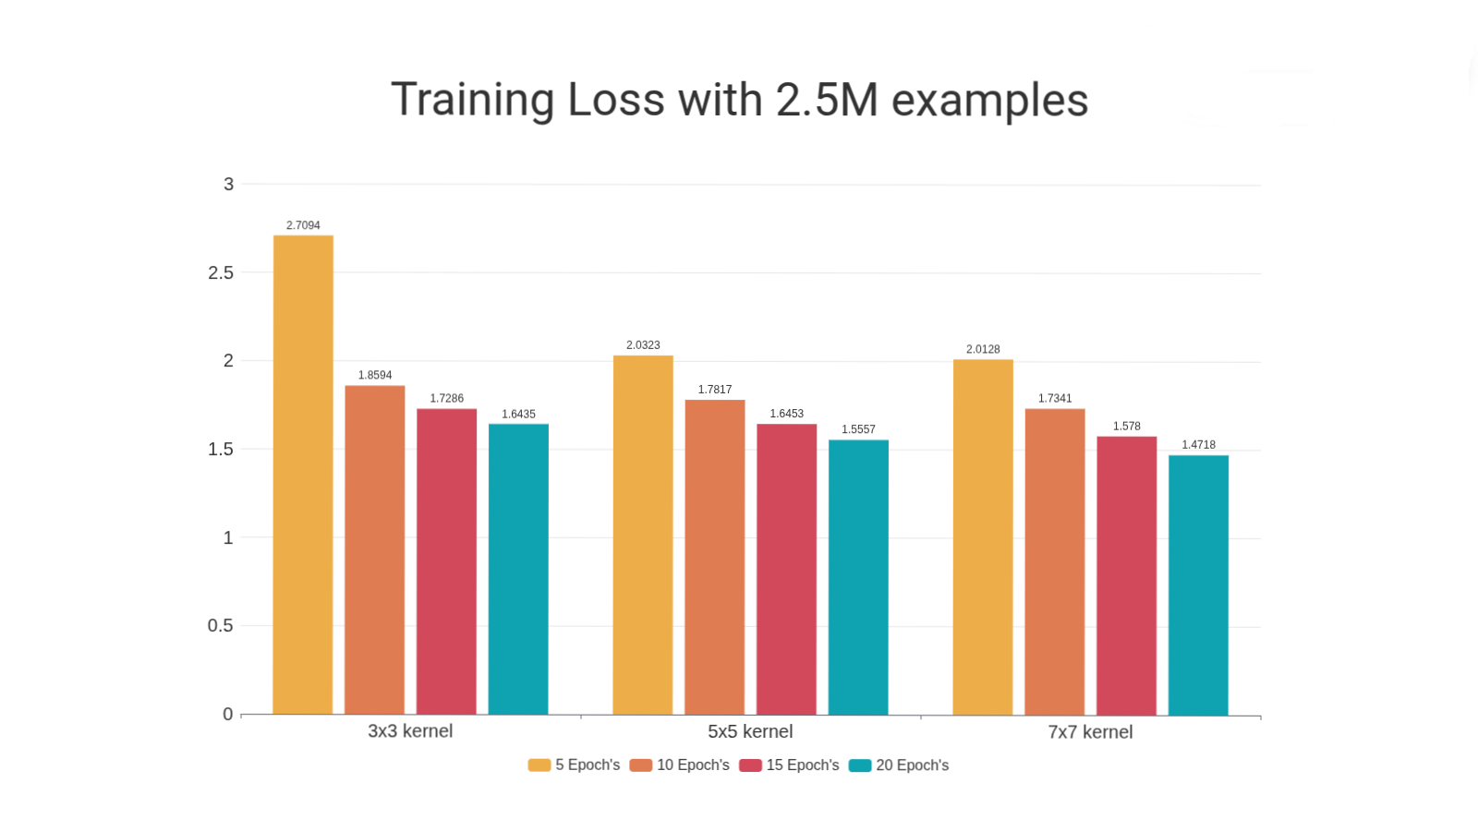
Model Architecture
Hyperparameters:
Tested different kernel sizes
3x3: 1.6435 loss
5x5: 1.5557 loss
7x7: 1.4718 loss
With padding sizes that outputted 8x8 channels

Slide 14
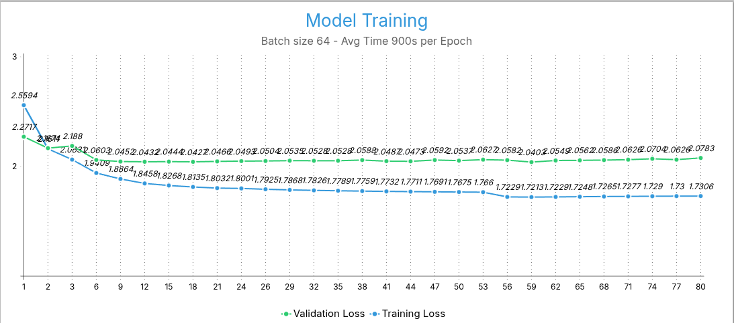
Model Training - 3x3 Kernel
Validation loss vs Training loss

Slide 15
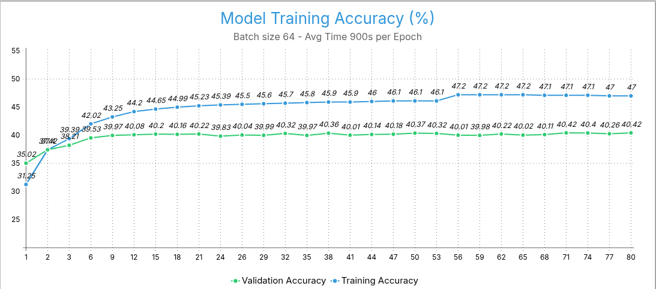
Model Training - 3x3 Kernel
Validation accuracy vs Training accuracy

Slide 16
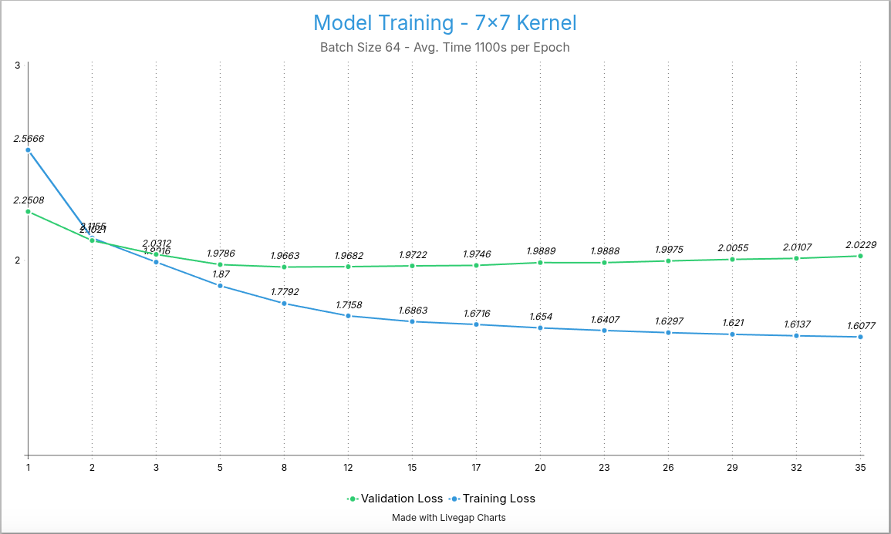
Model Training - 7x7 Kernel

Slide 17
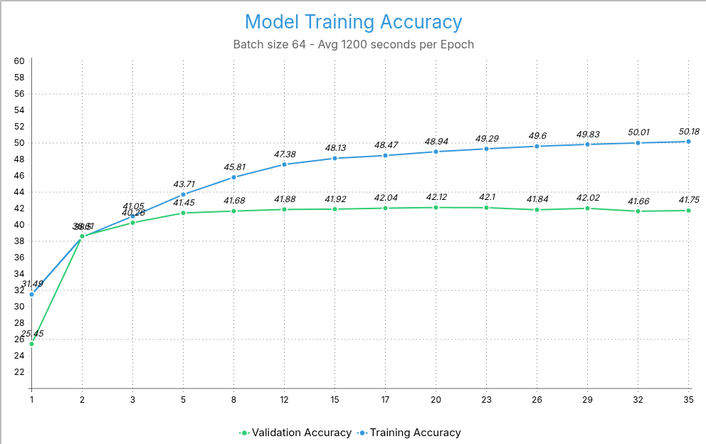
Model Training - 7x7 Kernel

Slide 18
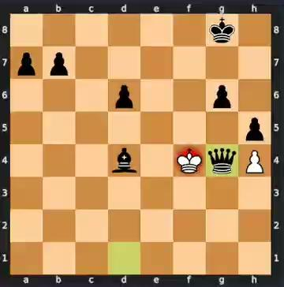
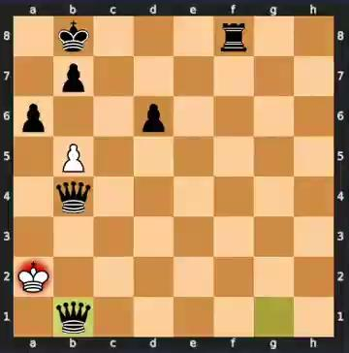
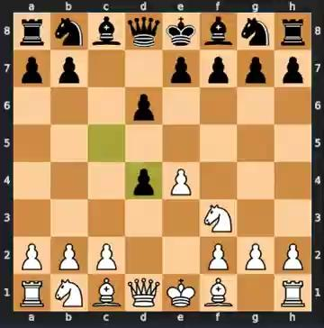
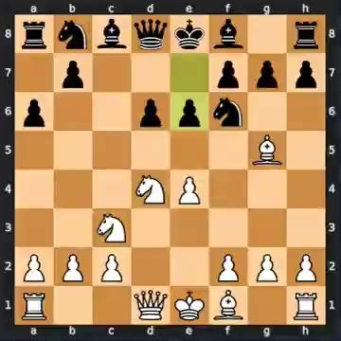
Tests
Tests made against Nikolai’s bot - 35 epochs 7x7 Kernel - Final model
We also tested 160 epochs in the first model, and 80 in the 3x3

Slide 19
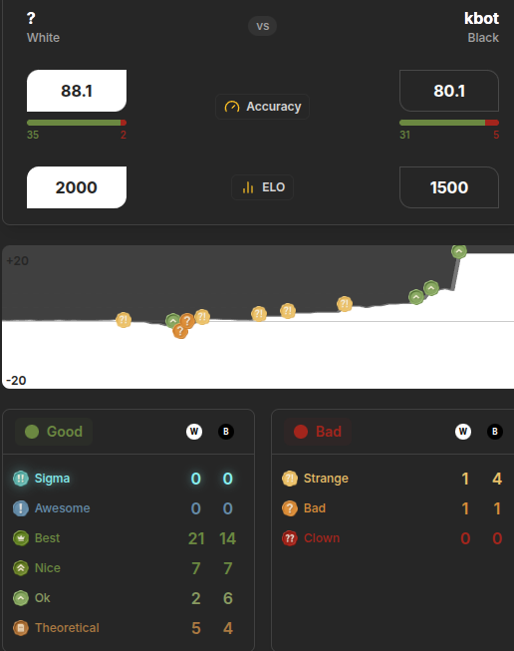
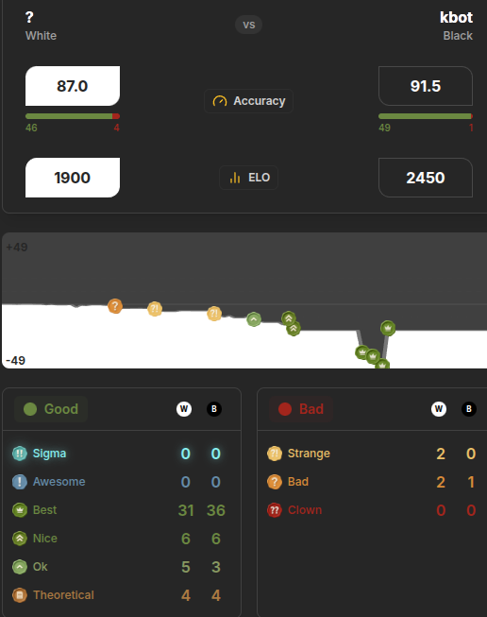
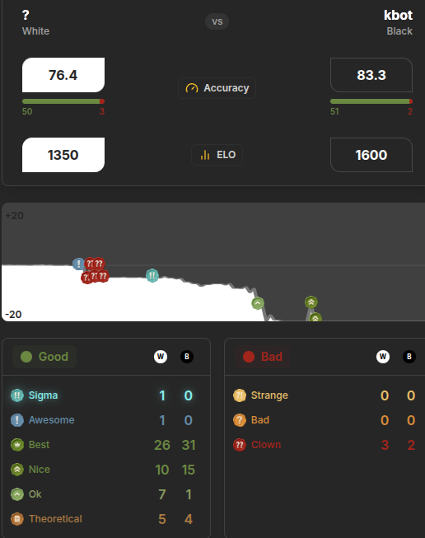
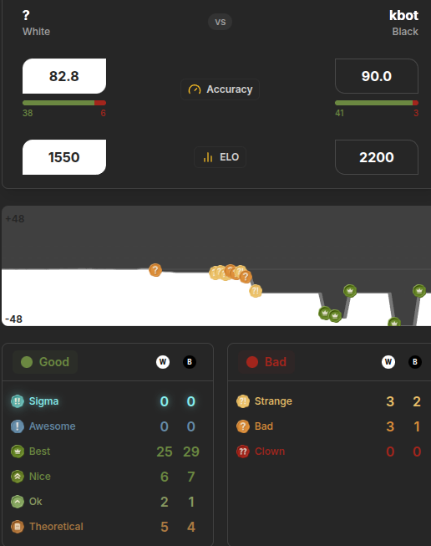
Tests
Evaluating models can be really subjective.
Stockfish became a way to “objectively” evaluate chess moves (almost like FIDE).
100-900 Beginner, 1000-1400 Intermediate, 1500-1900 Expert / Master, 2000-2500 Grandmaster 2500-+

Slide 20
Next steps
Reinforcement Learning
Experiment more (dataset, arquitecture, etc)
Endgame model, white model, evaluation model (heuristics), search tree

Slide 21
Conclusion
It’s very hard to evaluate chess, objectively who wins was better, you cannot win by being worse. A move that’s considered good today might not be in tomorrow’s standards under other super computer’s evaluation.
We are happy with what we built and since the main objective was to play like a human, we can 100% confirm that we accomplished that objective. Humans make blunders as well, and what normally distinguishes, or makes a player become better, isn’t it’s ceiling (the quality of good moves) but it’s floor (the amount of bad moves), persistence is better. You’re better by making less bad moves.
Our bot makes blunders but proved itself to play really well and even apply theory, and play objectively better moves.
We learned about different approaches, we learned about chess, we worked our way with python and deepened our knowledges.
We explored possibilities and read articles, we thought, and found solutions to our problems, and we consider that to be a bigger win than any chess game.

